Slide 1
Arithmetic Operations

Slide 2
Outline
Arithmetic Operations
Unsigned addition, multiplication
Signed addition, negation, multiplication
Using Shift to perform power-of-2 multiply
Suggested reading
Chap 2.3

Slide 3
Unsigned Addition
u
• • •
Operands: w bits
+
v
• • •
True Sum: w+1 bits
u + v
• • •
Discard Carry: w bits
UAdd_{w}(u , v)
• • •
unsigned 直接相加直接舍弃可能存在的最高位越界进位（mod 2^w）

Slide 4
Unsigned Addition
Standard Addition Function
Ignores carry output
Implements Modular Arithmetic
s = UAddw(u , v) = (u + v) mod 2^{w}

Slide 5
Unsigned Addition
Practice Problem 2.27
Write a function with the following prototype:
/* Determine whether arguments can be added without overflow */
int uadd_ok(unsigned x, unsigned y);
This function should return 1 if arguments x and y can be added without causing overflow
Overflow iff (X+Y) < X

Slide 6
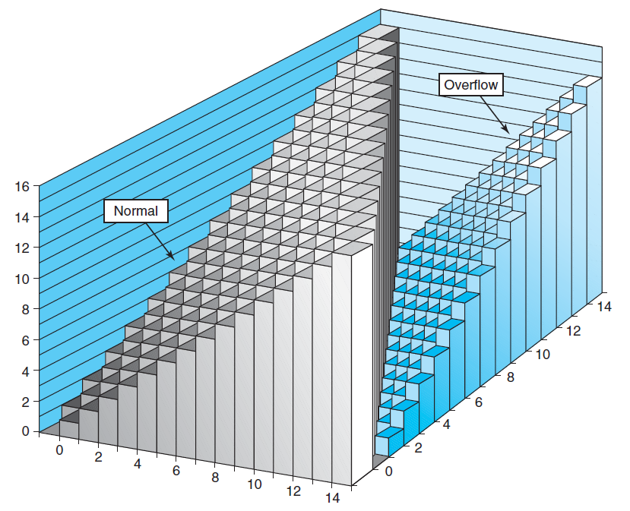
Unsigned Addition

Slide 7
Unsigned Addition Forms an Abelian Group(阿贝尔群)
Closed under addition
0 ≤ UAdd_{w}(u , v) ≤ 2^{w} –1
Associative
UAdd_{w} (t, UAdd_{w} (u,v)) = UAdd_{w} (UAdd_{w} (t, u ), v)
0 is additive identity
UAdd_{w} (u , 0) = u

Slide 8
Unsigned Addition Forms an Abelian Group
Every element has additive inverse(相反数)
Let UComp_{w} (u ) = 2^{w} – u
UAddw(u , UComp_{w} (u )) = 0
Commutative
UAdd_{w}(u , v) = UAdd_{w}(v , u)

Slide 9
Signed Addition
Functionality
True sum requires w+1 bits
Drop off MSB
Treat remaining bits as 2’s comp. integer

Slide 10
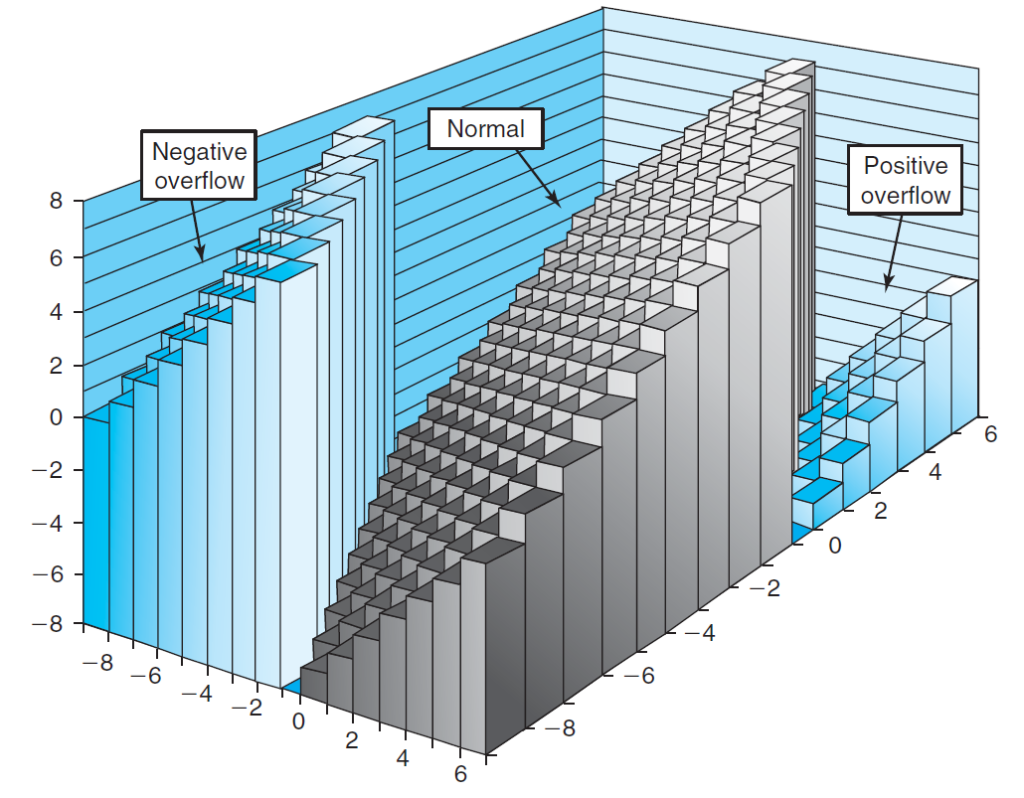
Signed Addition

Slide 11
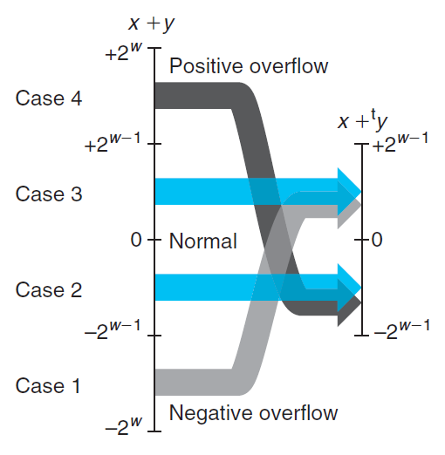
Signed Addition

Slide 12
Detecting Tadd Overflow
Task
Given s = TAdd_{w}(u , v)
Determine if s = Add_{w}(u , v)
Claim
Overflow iff either:
u, v < 0, s ≥ 0 (NegOver)
u, v ≥ 0, s < 0 (PosOver)
ovf = (u<0 == v<0) && (u<0 != s<0);

Slide 13
Mathematical Properties of TAdd
Two’s Complement Under TAdd Forms a Group
Closed, Commutative, Associative, 0 is additive identity
Every element has additive inverse
Let
TAdd_{w}(u , TComp_{w} (u )) = 0

Slide 14
Detecting Tadd Overflow
int tadd_ok_bugy(int x, int y)
{
int sum = x + y ;
return (sum-x == y) && (sum-y == x)
}
Abelian group(x+y-x=y+x-x, always true)
int tsub_ok_bugy(int x, int y)
{
return tadd_ok(x, -y) ;
}
Set y to TMIN, -y is also TMIN. If x is negative, add will always overflow, sub will not.

Slide 15
Mathematical Properties of TAdd
Isomorphic Algebra to UAdd
TAdd_{w} (u , v) = U2T (UAdd_{w}(T2U(u ), T2U(v)))
Since both have identical bit patterns
T2U(TAdd_{w} (u , v)) = UAdd_{w}(T2U(u ), T2U(v))

Slide 16
Negating with Complement & Increment
x
1
0
0
1
1
1
0
1
In C
~x + 1 == -x
Complement
Observation: ~x + x == 1111…111 == -1
Increment
~x + x + (-x + 1) == -1 + (-x + 1)
~x + 1 == -x
+
~x
0
1
1
0
0
0
1
0
-1
1
1
1
1
1
1
1
1

Slide 17
Multiplication
Computing Exact Product of w-bit numbers x, y
Either signed or unsigned
Ranges
Unsigned: 0 ≤ x * y ≤ (2^{w} – 1) ² = 2^{2w} – 2^{w+1} + 1
Up to 2w bits
Two’s complement min: x *y ≥–2^{w–1}*(2^{w–1}–1) = –2^{2w–2} + 2^{w–1}
Up to 2w–1 bits
Two’s complement max: x * y ≤ (–2^{w–1}) ² = 2^{2w–2}
Up to 2w bits, but only for TMinw²

Slide 18
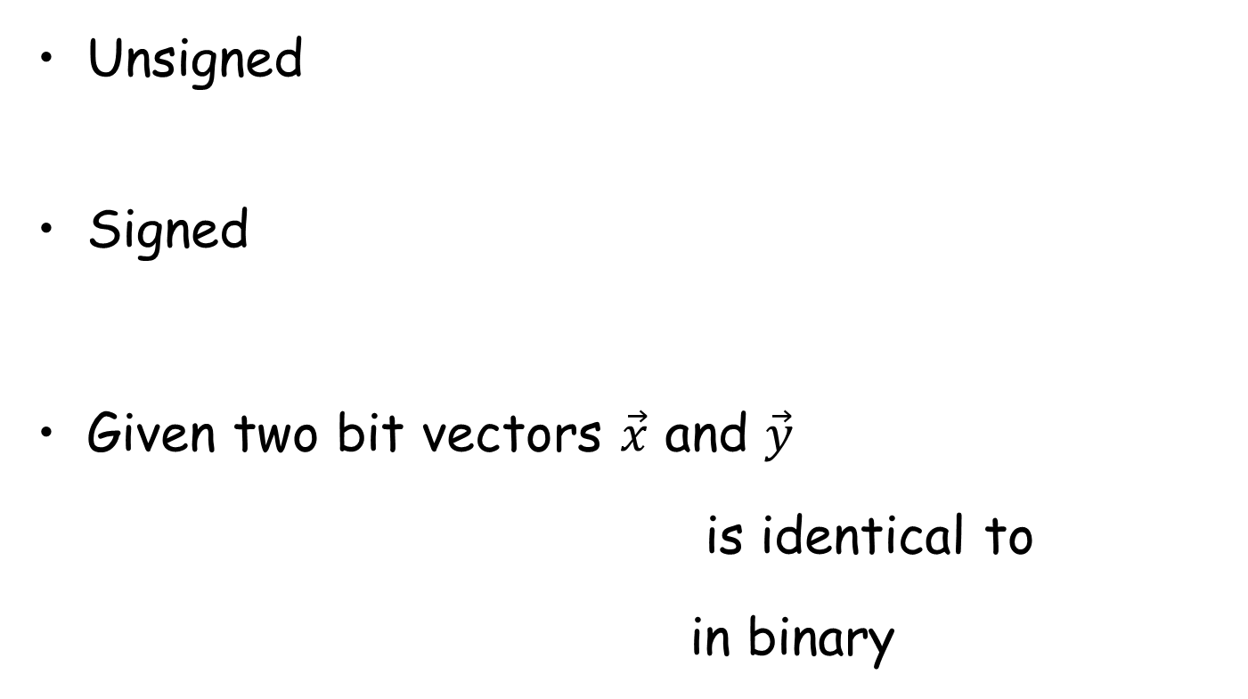





Multiplication

Slide 19
Multiplication
Maintaining Exact Results
Would need to keep expanding word size with each product computed
Done in software by “arbitrary precision” arithmetic packages

Slide 20
Multiplication
Maintaining Exact Results
Would need to keep expanding word size with each product computed
Done in software by “arbitrary precision” arithmetic packages

Slide 21
Power-of-2 Multiply with Shift
k
u
• • •
Operands: w bits
*
2^{k}
0
•••
0
1
0
•••
0
0
True Product: w+k bits
u · 2^{k}
• • •
0
•••
0
0
Discard k bits: w bits
UMult_{w}(u , 2^{k})
•••
0
•••
0
0
TMult_{w}(u , 2^{k})
计算机一般会将一个乘法分解成几个乘法，使其尽量满足2^k，从而只通过左移位运算来简化乘法。

Slide 22
Power-of-2 Multiply with Shift
Operation
u << k gives u * 2^{k}
Both signed and unsigned
Examples
u << 3 == u * 8
u << 5 - u << 3 == u * 24
Most machines shift and add much faster than multiply
Compiler will generate this code automatically

Slide 23
Security Vulnerability in the XDR Library
1 /*
2 * Illustration of code vulnerability similar to that found in
3 * Sun’s XDR library.
4 */

Slide 24
Security Vulnerability in the XDR Library
5 void* copy_elements(void *ele_src[], int ele_cnt, size_t ele_size) {
6 /*
7 * Allocate buffer for ele_cnt objects, each of ele_size bytes
8 * and copy from locations designated by ele_src
9 */
10 void *result = malloc(ele_cnt * ele_size);
11 if (result == NULL)
12 /* malloc failed */
13 return NULL;

Slide 25
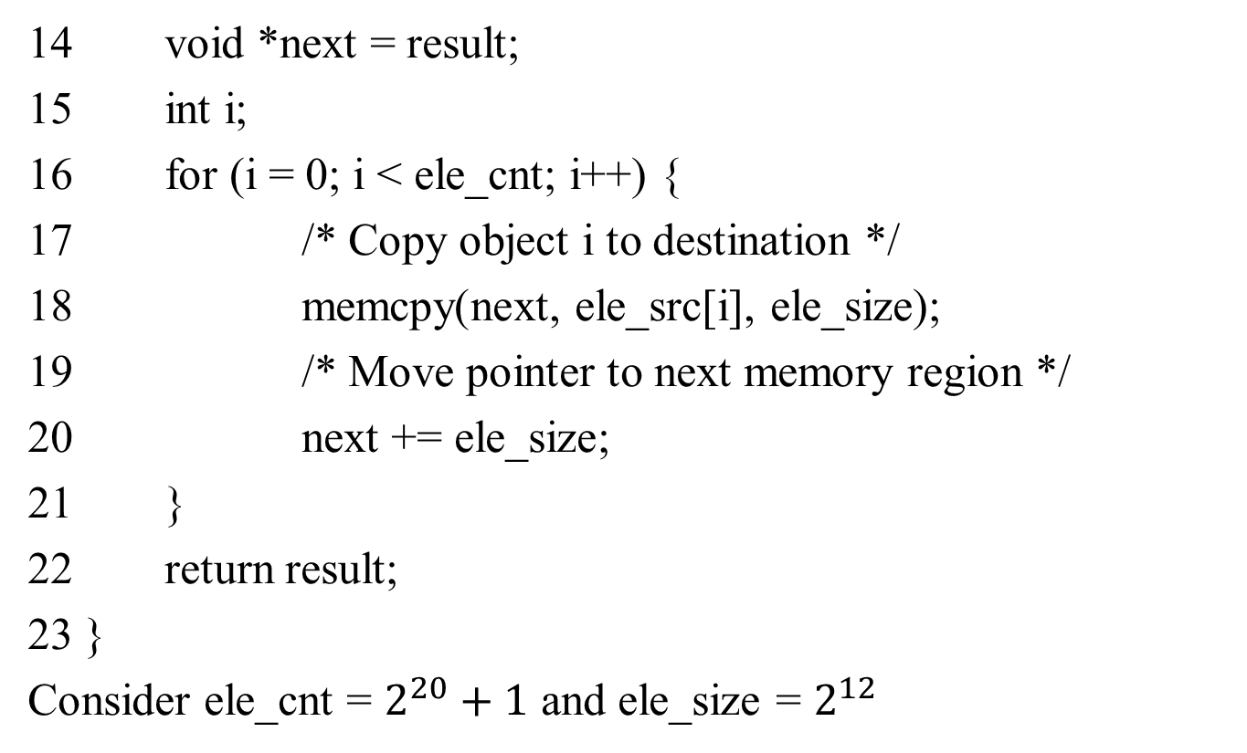
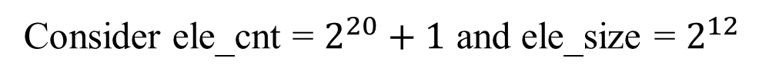
Security Vulnerability in the XDR Library
on

